Slide 1

MARS: Masked Automatic Ranks Selection in Tensor Decomposition
Paper Review
UFO Team

Slide 2
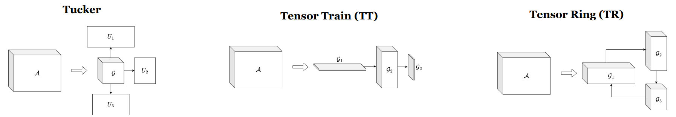
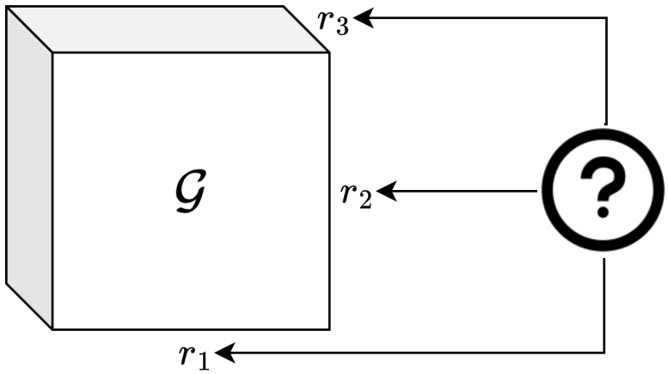
Motivation&Problem: Tensor decomposition methods are effective in compression and acceleration of neural networks. However, to achieve balance between compression and performance we need to carefully select tensor ranks.
Typical hyperparameter selection techniques, like cross-validation, are poorly suited for the choice of multiple tensor ranks.
Existing approaches for core ranks selection are not general. They also could require significant computational overhead.

Slide 3
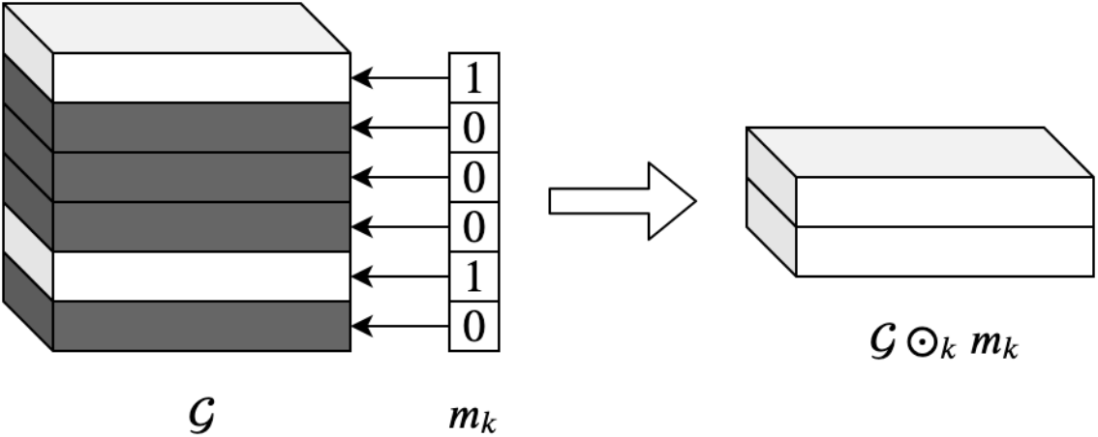
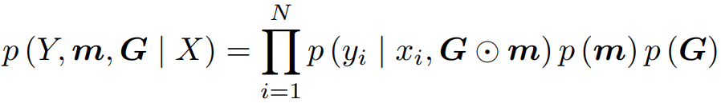
Proposed method
Ranks can be represented by binary masks over tensor dimensions
Bayesian model for these binary masks is proposed, MAP estimate is considered
Learned masks are binarized and applied to core tensors, resulting in compressed model

Slide 4
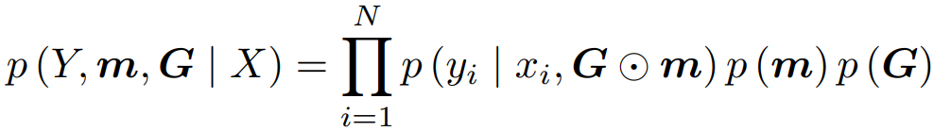
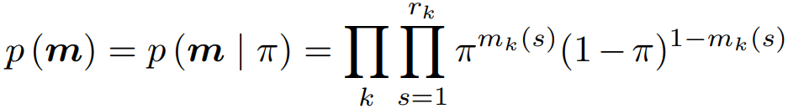
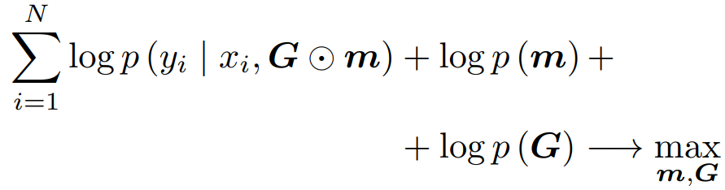
Model
Prior over masks is assumed to be Bernoulli with the success parameter π
MAP estimate is considered. This discrete optimization problem can be reduced to continuous optimization

Slide 5
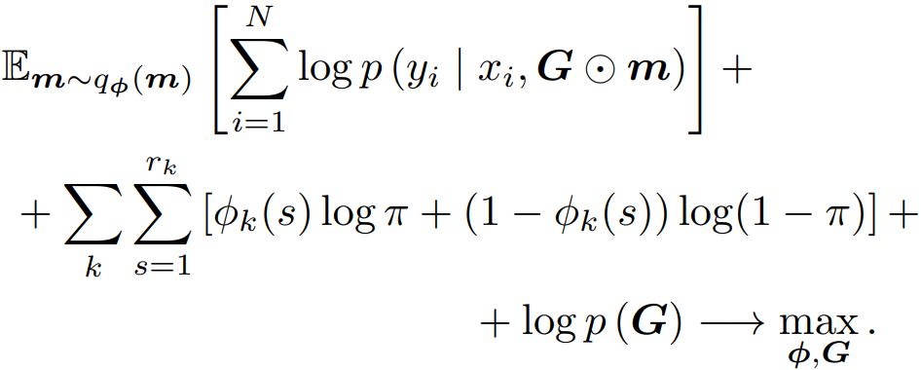
Model
Under the assumption that q(m) is a factorized Bernoulli distribution, problem from previous slide is equivalent to
After applying reparameterization trick, we can use stochastic gradient descent to get MAP estimate of G (cores) and ϕ (probability parameter from Bernoulli distribution of masks).
Finally, binary masks are obtained by rounding ϕ
Mode-k Hadamard product between cores and corresponding masks gives compressed tensors.

Slide 6
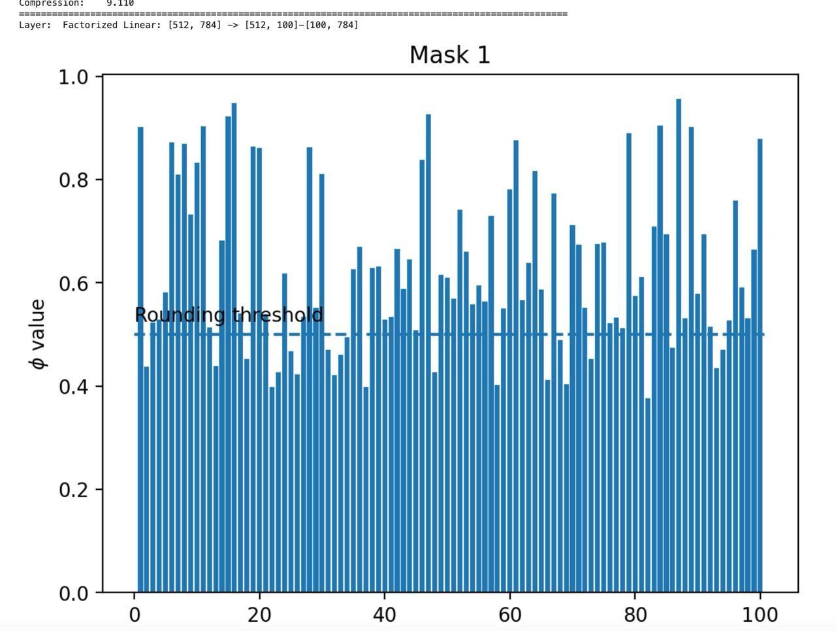
Reproducing paper results
https://github.com/xiyori/mars-reproducibility
The code provided by the authors only reproduces 1 experiment with a simple fully-connected model
We implement 2 more experiments: LeNet-5 on MNIST and ResNet-110 on CIFAR10
Our results align with the paper sufficiently well

Slide 7
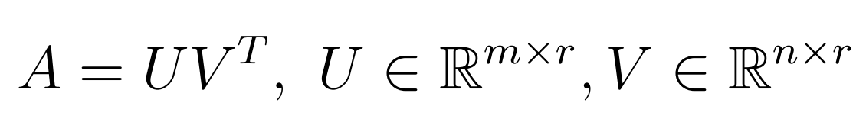
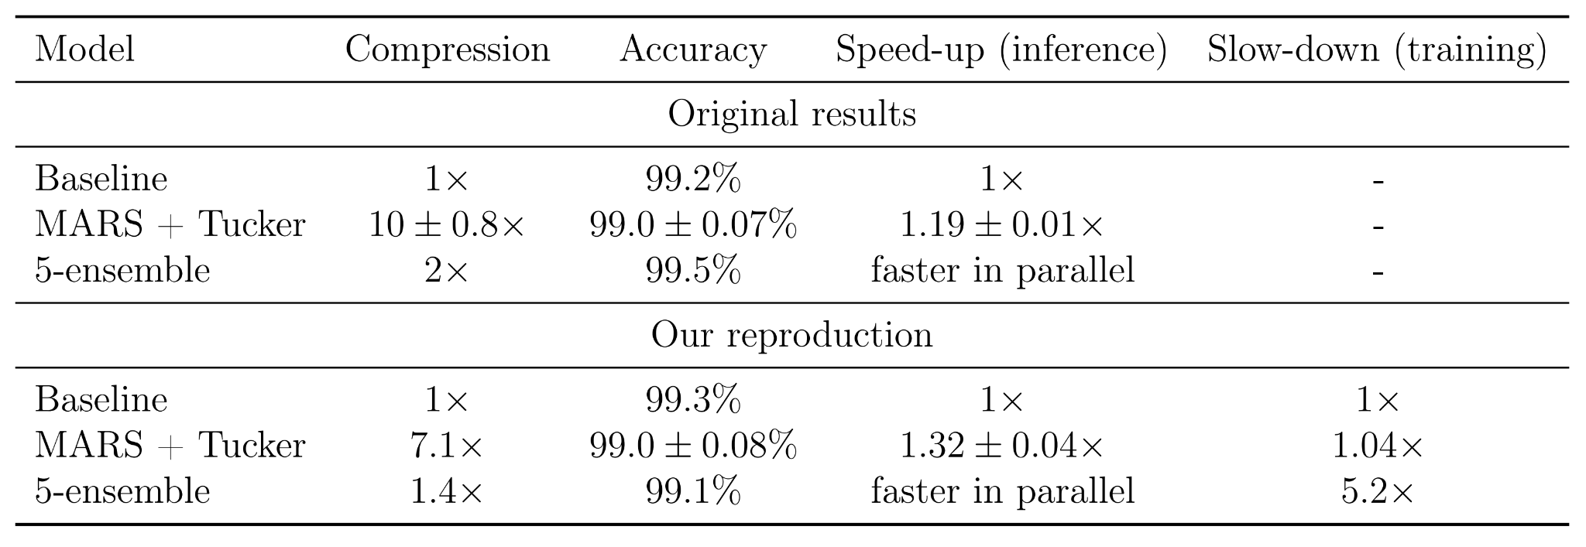
Reproducing paper results: LeNet-5
Tucker decomposition for convolution
Low-rank factorization for linear (Skeleton decomposition!)

Slide 8
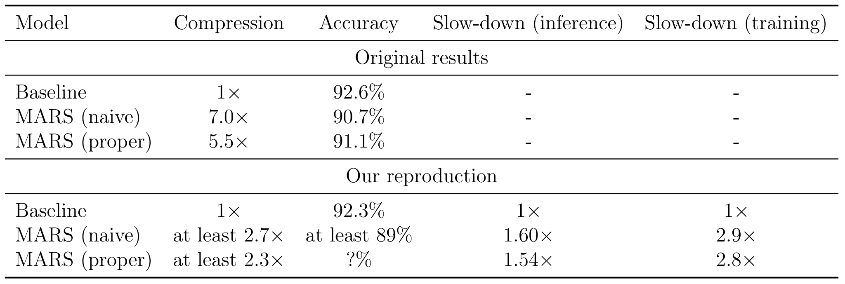
Reproducing paper results: ResNet-110
Tensor Train for convolutions in 2nd and 3rd blocks
Naive: 2d + 1 tensors r_{k-1} x n_{k} x r_{k}
Proper: similar number of tensors r_{k-1} x n_{k} x m_{k} x r_{k}, inspired by Garipov et al. (2016)

Slide 9
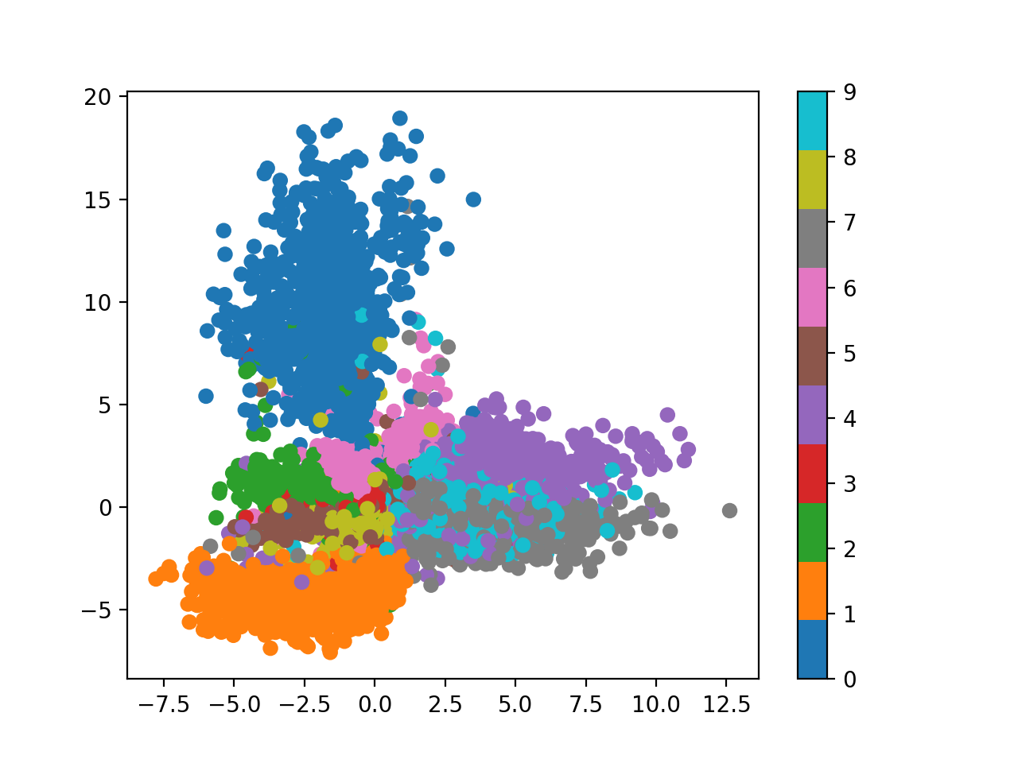
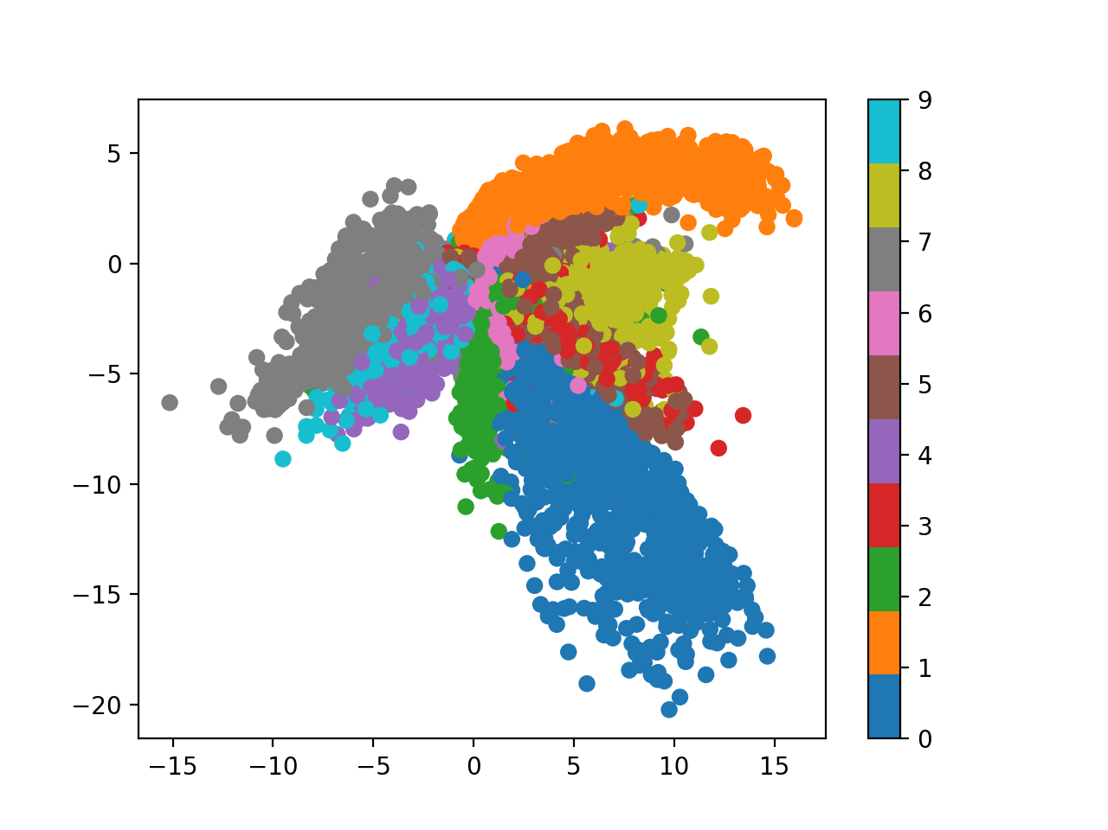
MARS for AutoEncoders
Factorized autoencoders latent space
Compression: 3.819
Base autoencoders latent space’s latent space

Slide 10
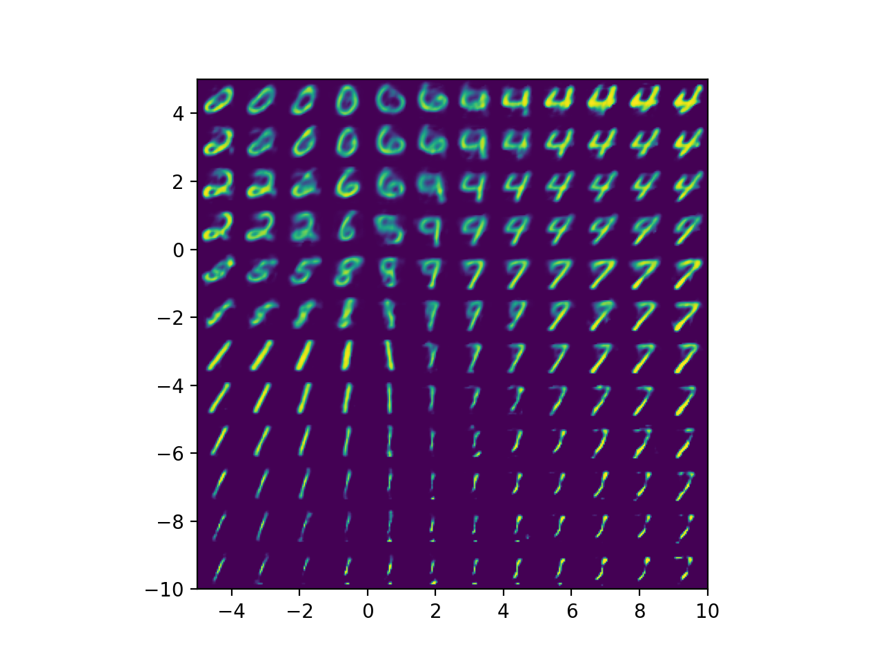
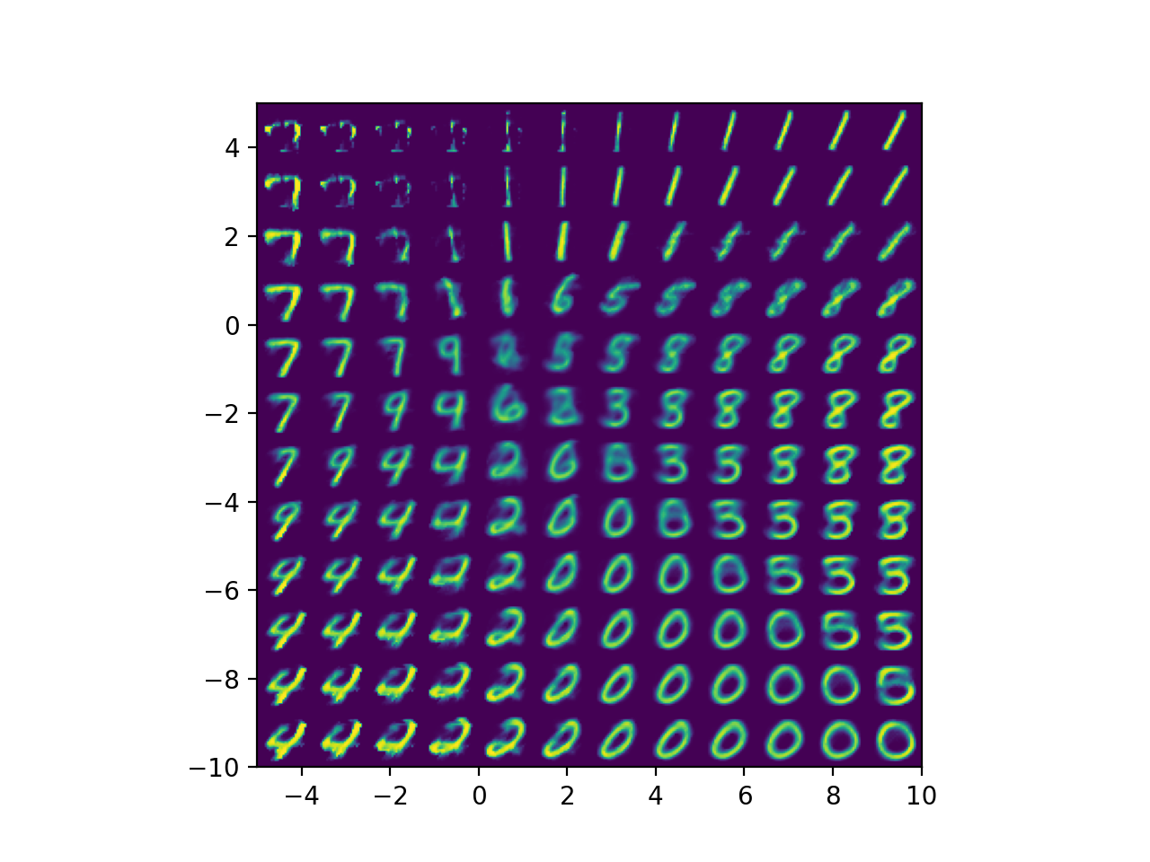
MARS for AutoEncoders
Factorized autoencoder reconstruction
Inference speedup: 1.11
Base autoencoder reconstruction

Slide 11
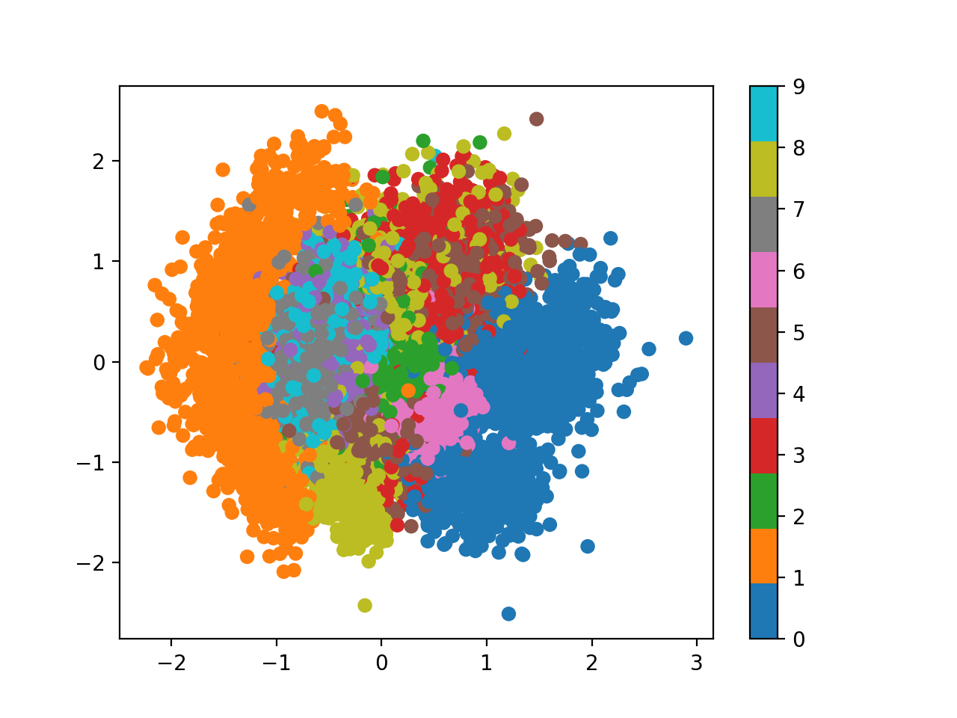
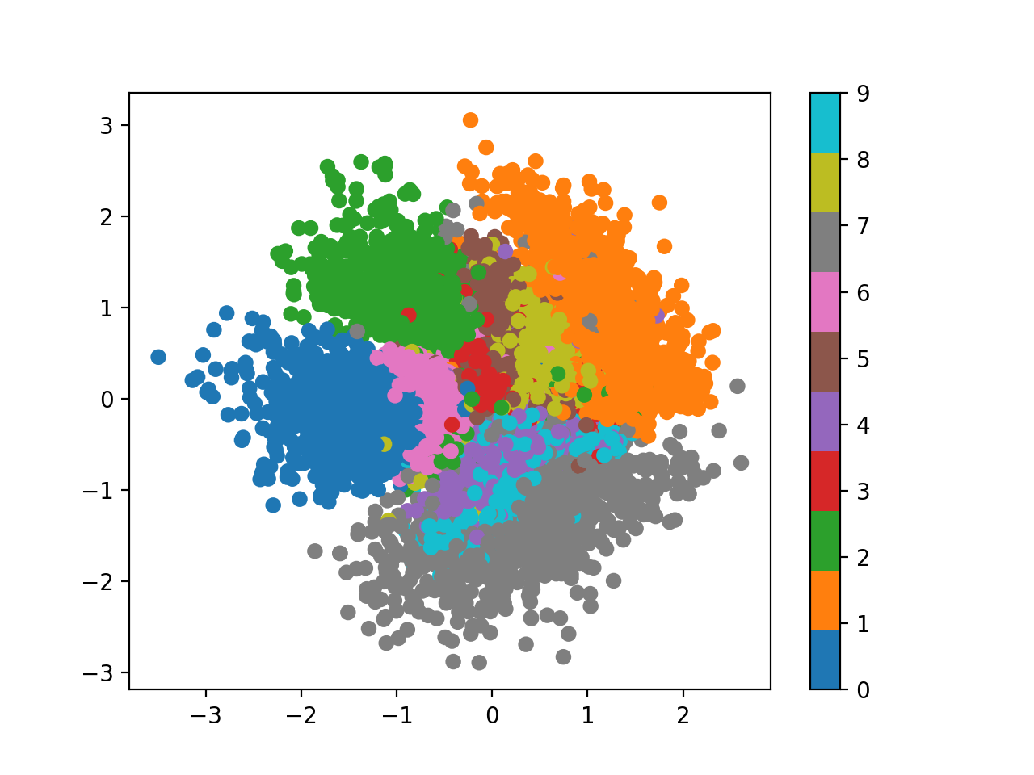
MARS for VAE
Factorized VAE latent space
Compression: 5.383
Base VAE latent space

Slide 12
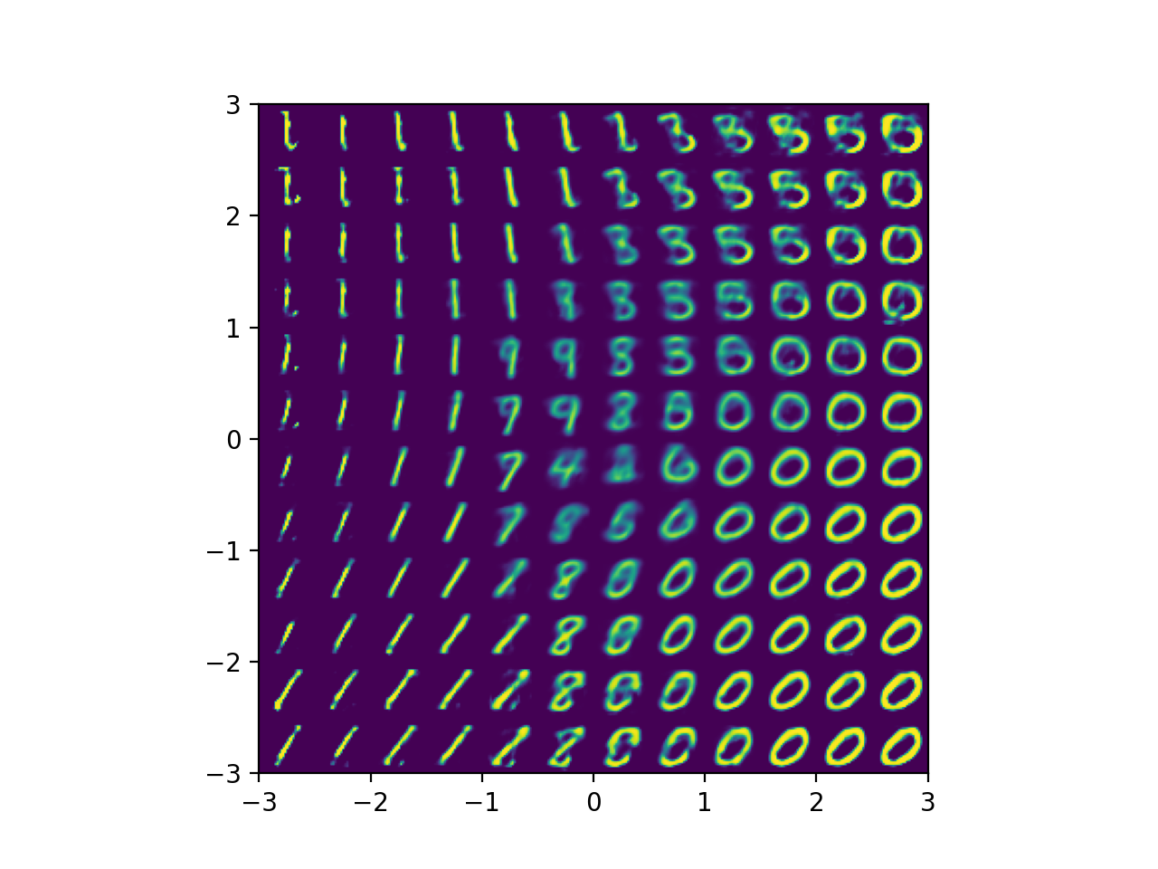
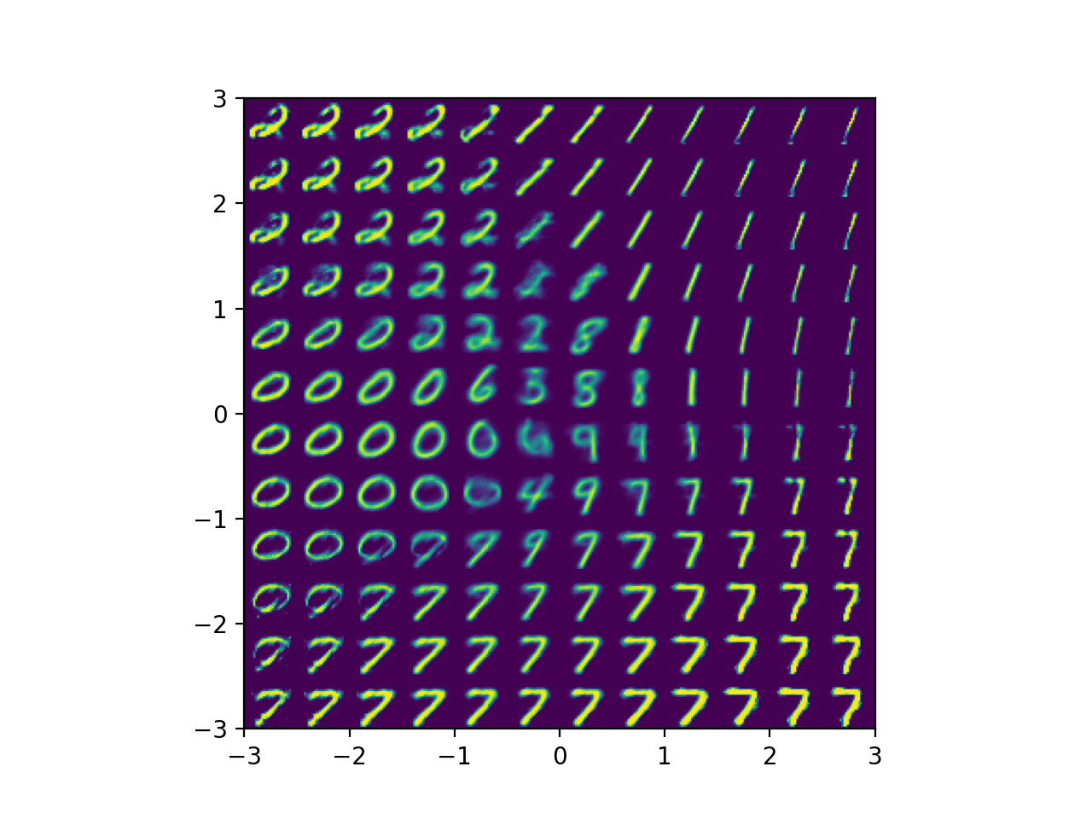
MARS for VAE
Factorized VAE reconstruction
Inference speedup: 1.12
Base VAE reconstruction

Slide 13


MARS for VAE
Factorized VAE transition
Base VAE transition

Slide 14
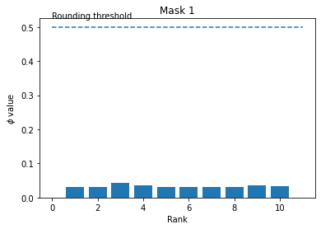
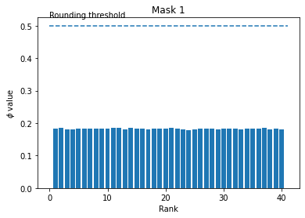
MARS for U-Net
Approach for U-Net:
Replace ordinary convolution blocks with either ones based on TT or Tucker decomposition (similar to famous approach with MobileNet convolutions)
As a result, size of model decreases from the start
Challenges:
Hard to make large model to “take off”
During training MARS more likely to not find any structure inside of models at all and give a zero mask
Training process take 2x-3x more time, than for ordinary U-Net, because requires some time after convergence to find a mask

Slide 15
Conclusion
Model Advantages
Universal - applicable to various tensorized models
Sensible - closely rank approximation
Effective - much better than manual selection of ranks and no worse than specialized rank selection schemes
Efficient - no extra computational cost
Scalable - easy tensorization of ResNet-110
Consistent - learned masks probabilities are close to hard values {0, 1}
Model Disadvantages
In practice it is difficult to choose hyperparameters
Ensemble learning approach is quite long
Model is working long for TensorTrain rank selection

Slide 16
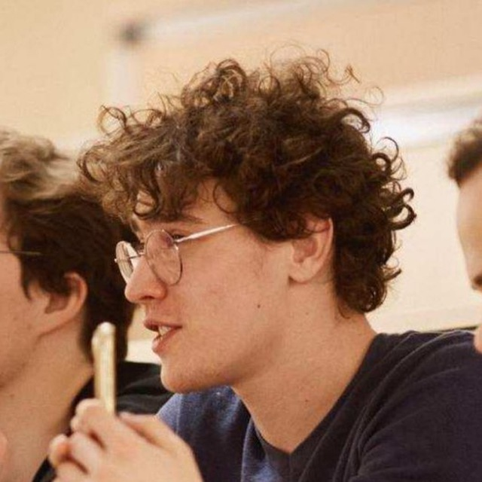

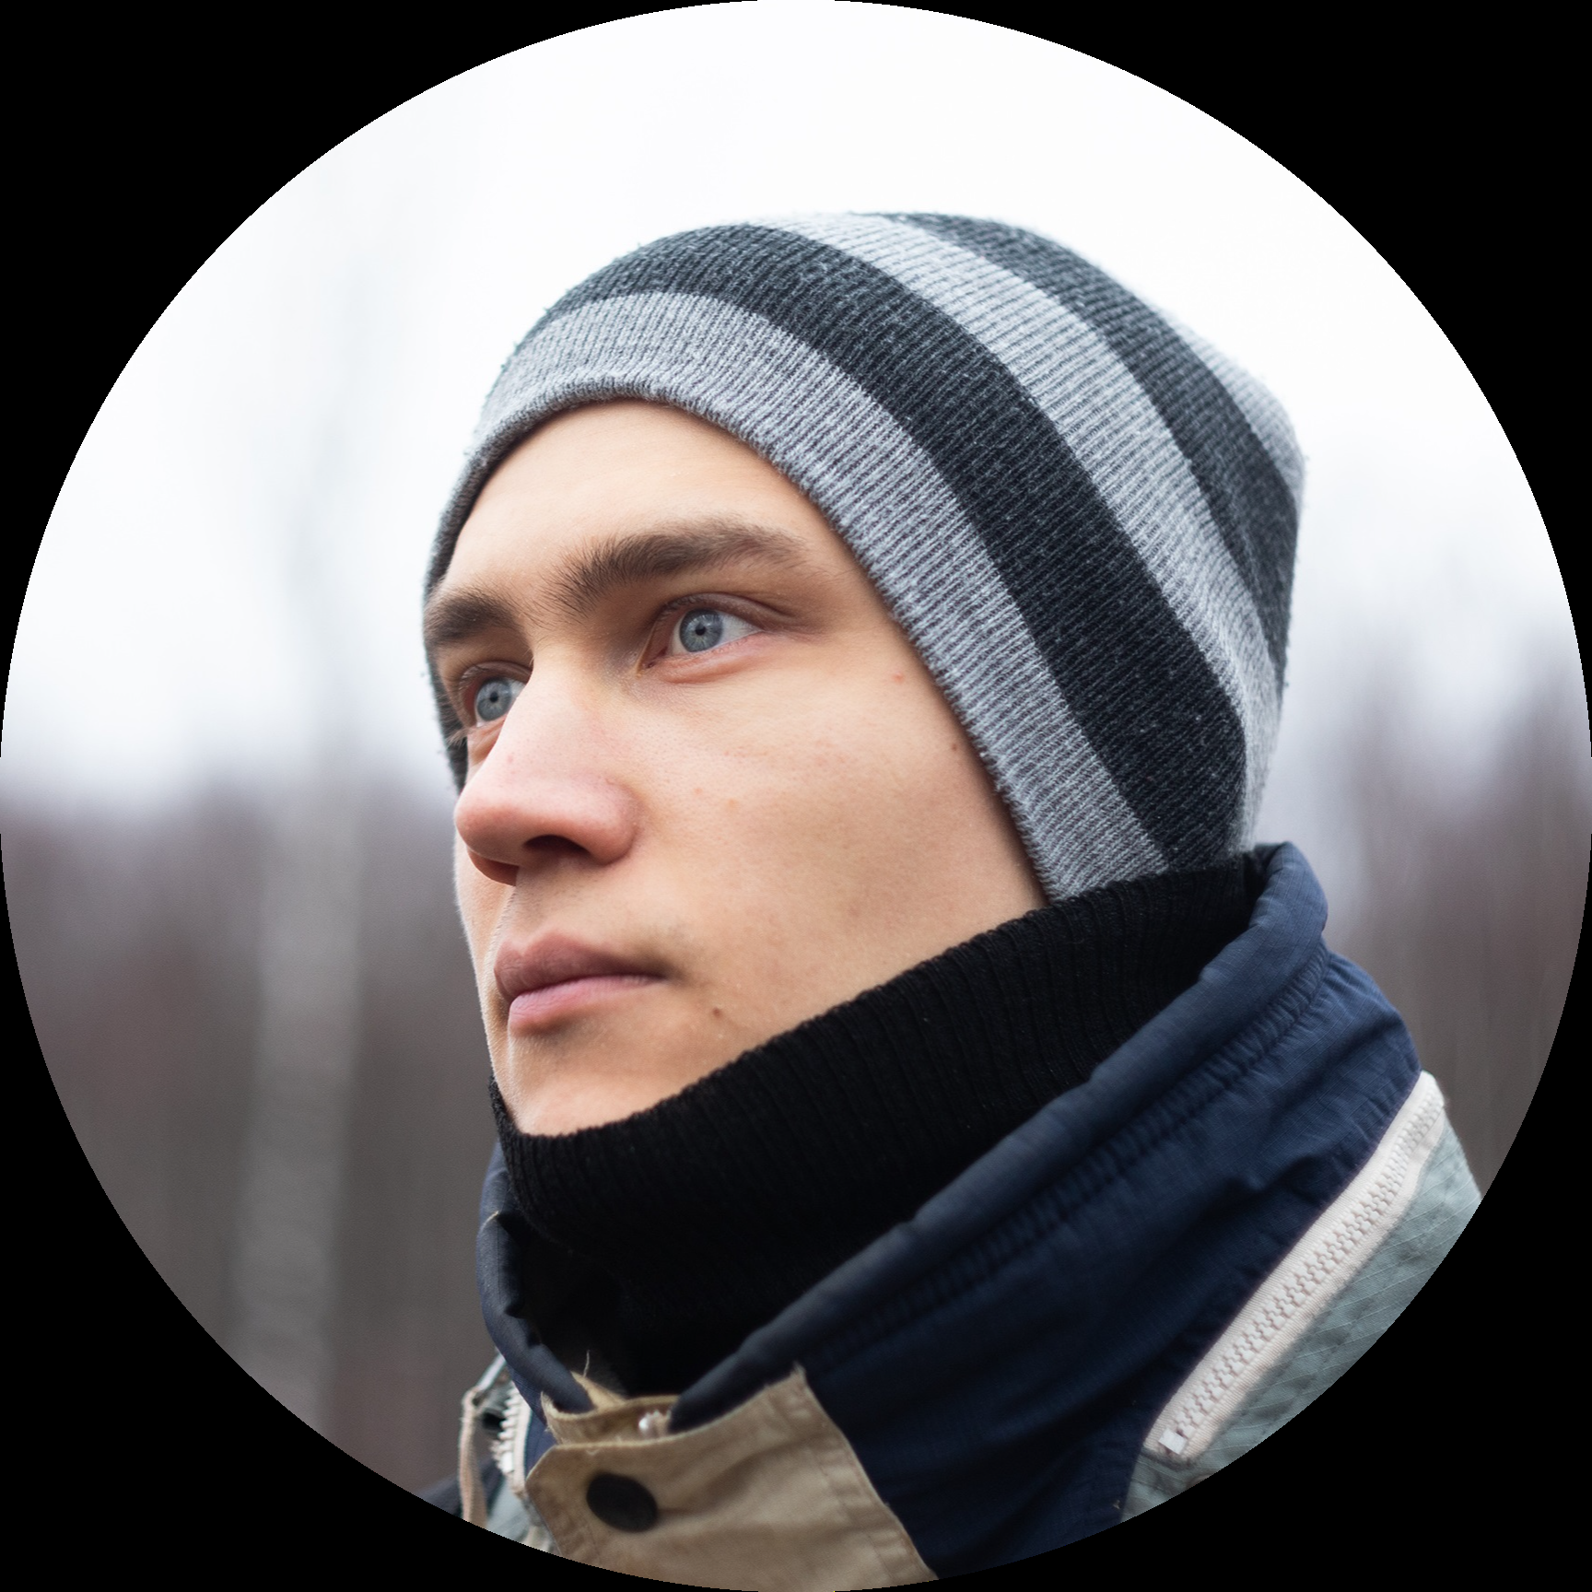


Our Team
Elfat Sabitov Experimental applications
Petr Sychev Theory understanding, preso
Foma Shipilov Experiments reproduction
Petr Kushnir Theory understanding, preso
Sergey Kushneryuk Experiments with CNN

